Slide 1
SDSC 2005 - Introduction to Computational Social Science (Lecture 5)
Hao PENG
(haopeng@cityu.edu.hk)
Department of Data Science
City University of Hong Kong
https://haoopeng.github.io/

Slide 2
Agenda today
(last week: how to build features from raw data)
Supervised machine learning models
(Binary) classification problems
Logistic regression, Naïve Bayes, KNN
Model evaluation metrics
True vs. False positive rate, AUC-ROC
Precision vs. Recall, F1
Model selection based on test data
Python tutorial
Scikit-learn

Slide 3
Statistical machine learning
Machine Learning constructs algorithms that can learn from historical data, which is especially useful for predictions.
Statistical Learning is a branch of statistics developed in response to Machine learning; It emphasizes building statistical models for drawing inferences & correlations between variables and assessing uncertainty.
Data Science is the extraction of knowledge from data, using tools from statistics, computer science, engineering . . .
(there is a “data science” in almost every domain now)

Slide 4
Supervised vs. Unsupervised learning
Supervised Learning: Both inputs (a.k.a. features, predictors, covariates, independent variables) and outputs (a.k.a. labels, targets, responses, dependent variable) are in training data.
Unsupervised: Only inputs in training data; no outputs.

Slide 5
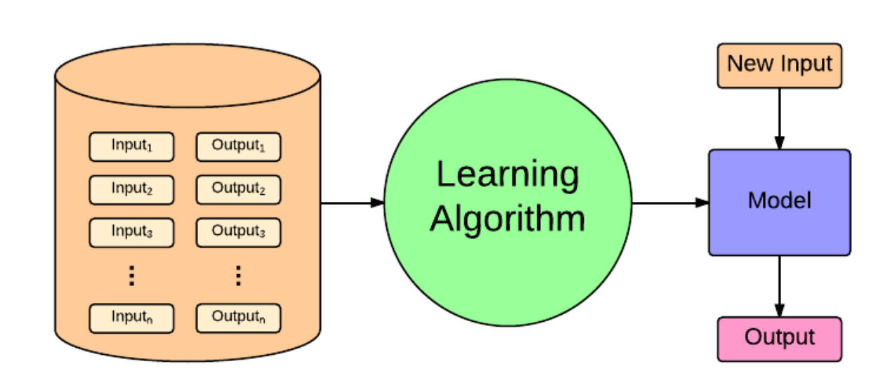
Supervised learning paradigm

Slide 6
Supervised learning examples
Use classification techniques to identify which accounts are more likely to upgrade to premium services (this helps the salesforce to know which accounts to focus on to sell more).
Use regression models to improve how sales attract prospective clients and uncover what features of the company’s services they should highlight in marketing.

Slide 7
An exercise
Are the following problems supervised or unsupervised?
If they are supervised problems, are they regression (output is numerical) or classification (output is categorical) problems?
Problem 1: Given a database of customer data, automatically discover market segments and group customers into different market segments.
Problem 2: You have a large inventory of identical items. You want to predict how many of these items will sell over the next 3 months.
Problem 3: You’d like software to examine individual customer accounts, and for each account decide if it has been hacked/compromised.

Slide 8
Supervised learning
Outcome measurement Y
output, response, target, dependent variable
Vector of p predictors / measurements X
inputs, regressors, covariates, features, independent variables
These are called observations or samples.
In a regression problem, Y is quantitative
E.g., likes, comments, views, age, price
In a classification problem, Y takes values in a set of labels
E.g., gender, education level, personality type
We have training data (x₁, y₁), . . . ,(x_{N} , y_{N} ).
Classification is perhaps the most widely used ML method.
Examples in the previous class?

Slide 9
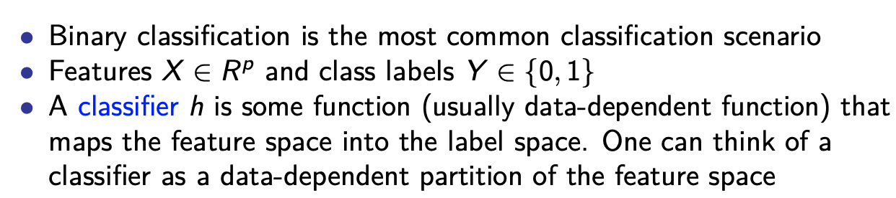
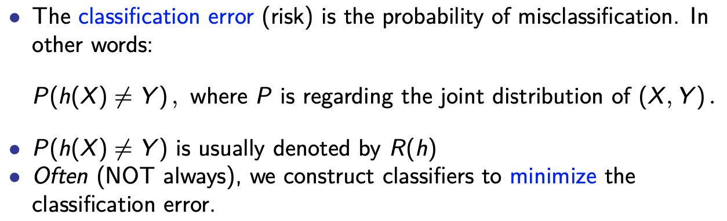
What is the usual objective?

Slide 10
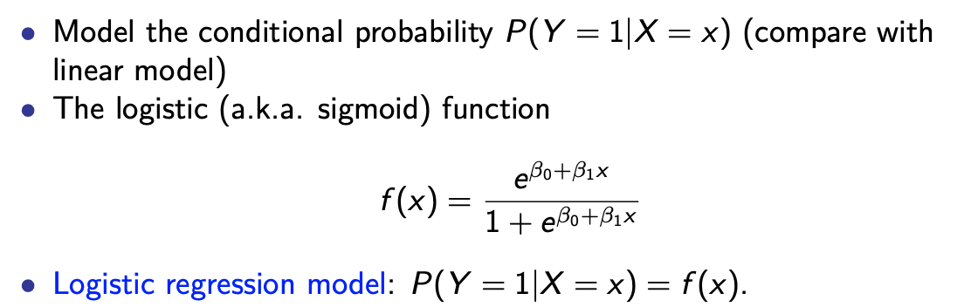
Logistic regression

Slide 11
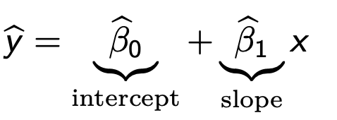
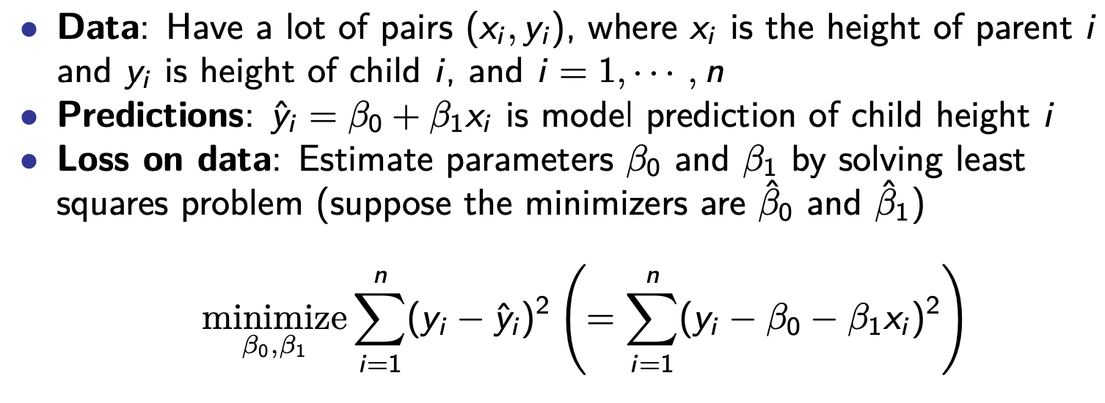
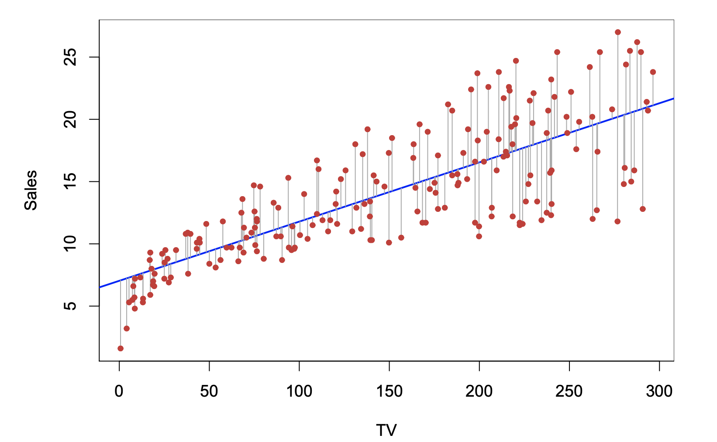
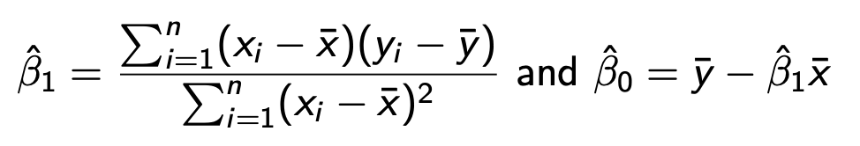
How to predict sales using variables such as num. of TV ads?
Recall linear regression
A simple model:
Find the best fitted line of this form. (what does “best” mean?)
People in the pre-computer age use an exact formula:

Slide 12
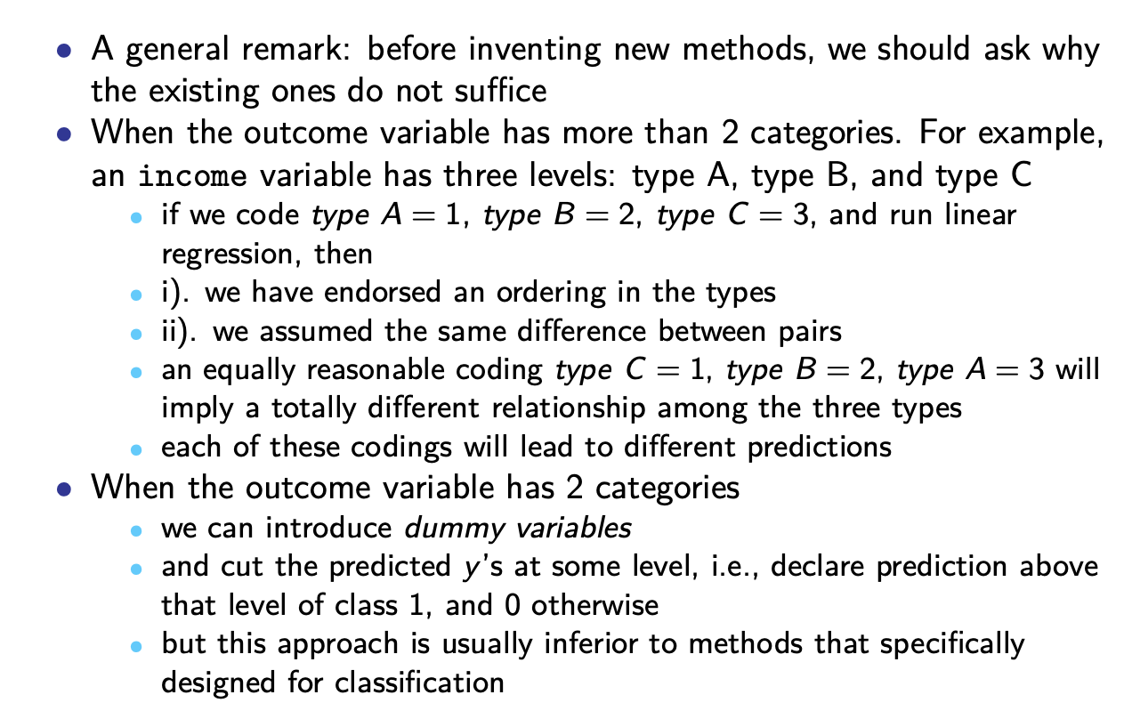
Why not using linear regression?

Slide 13
Logistic regression
What’s the unique characteristic of the sigmoid function f(x)?
Why can we use it to model a binary DV? What’s the range of f(x)?
How to fit a logistic regression model to data?

Slide 14
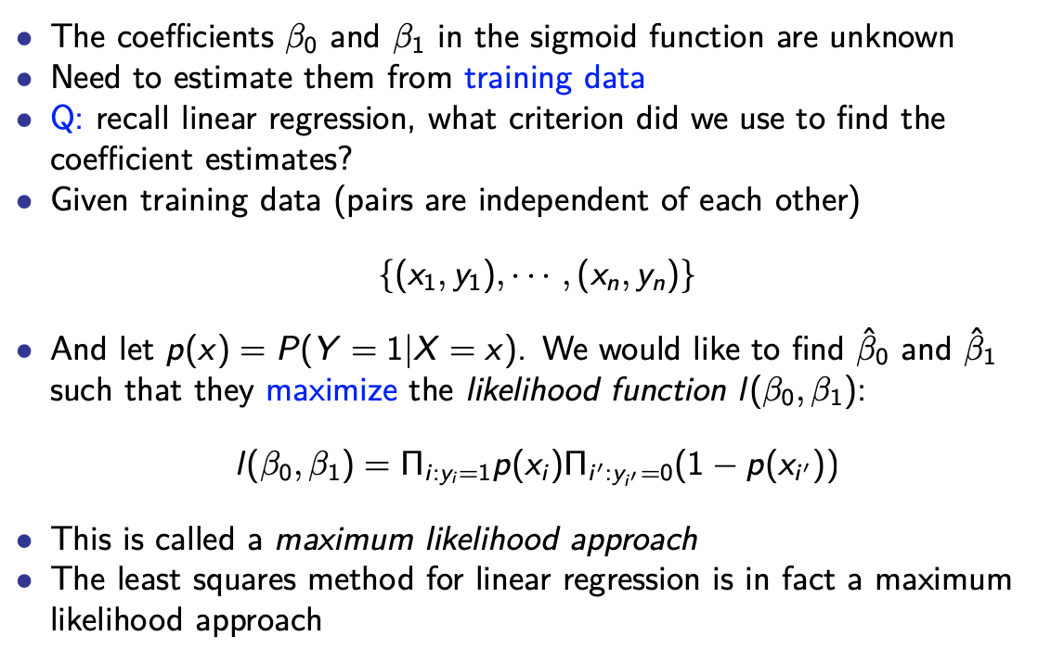
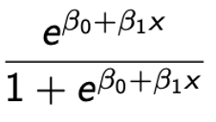
Fitting Logistic regression
p(x) =
Python implementation and tutorial (must read!):
https://www.datacamp.com/tutorial/understanding-logistic-regression-python
Notes:
Some obs (i) have y = 1, others (I’) have y = 0.

Slide 15
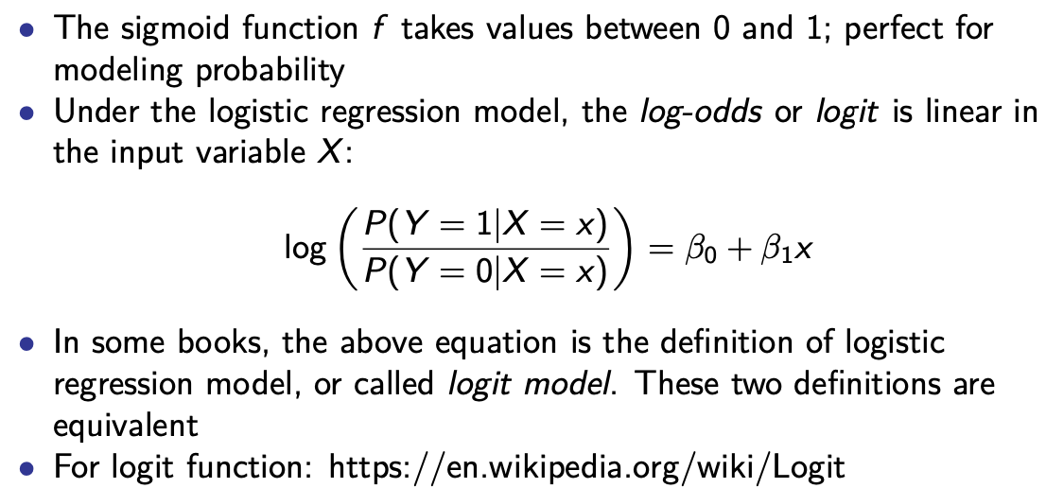
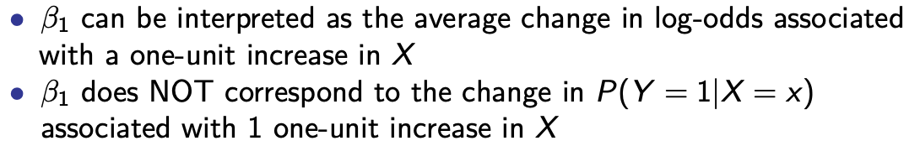
Interpreting coefficients in logit model
log Odds =
log [f(x) / (1 – f(x)] = β₀ + β₁X

Slide 16
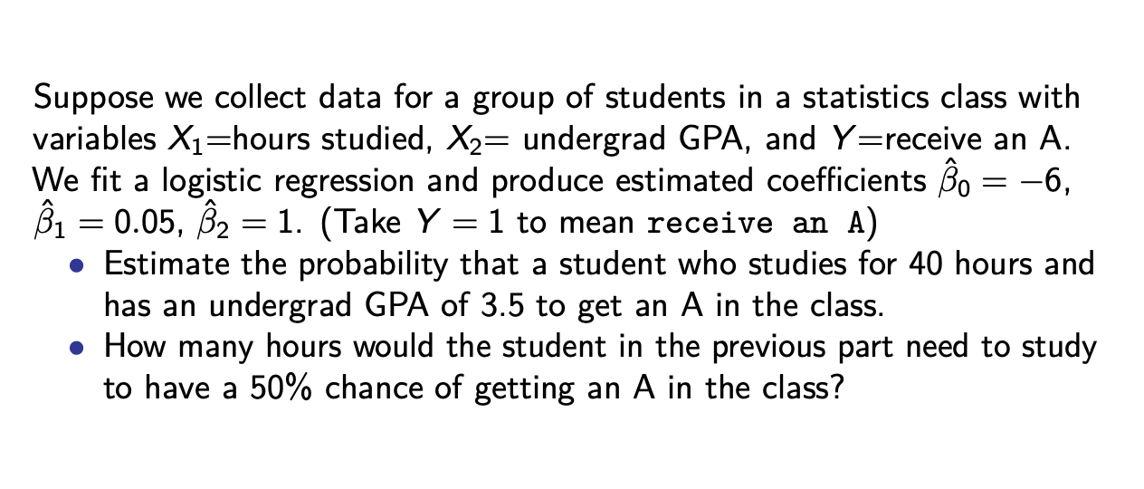
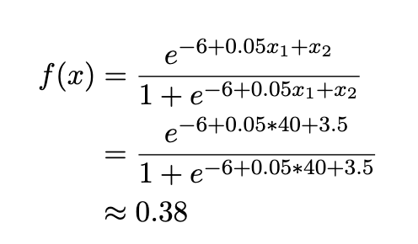
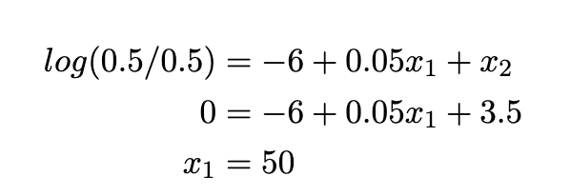
Logit classification example
Estimate the probability:
How many hours?
A 10 unit increase in X₁ is not associated with 10 x β₁ = 0.5 increase in P(Y=A). But the log (odd ratio) increases by 0.5 [Do the calculation: log (0.38/0.62) = - 0.5].

Slide 17
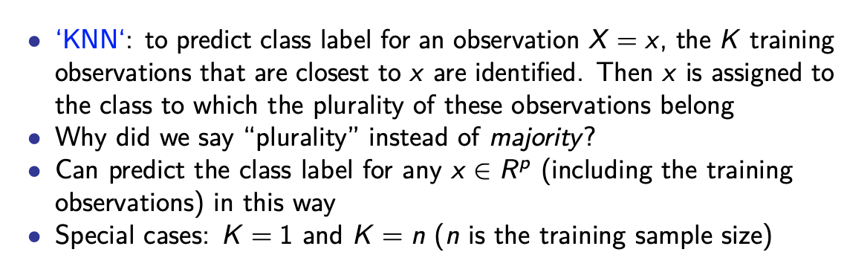
K-nearest neighbors (KNN)
The key is to define a proper distance function.
(Manhattan Distance, Euclidean Distance, Cosine distance, etc.)
https://www.kdnuggets.com/2020/11/most-popular-distance-metrics-knn.html

Slide 18
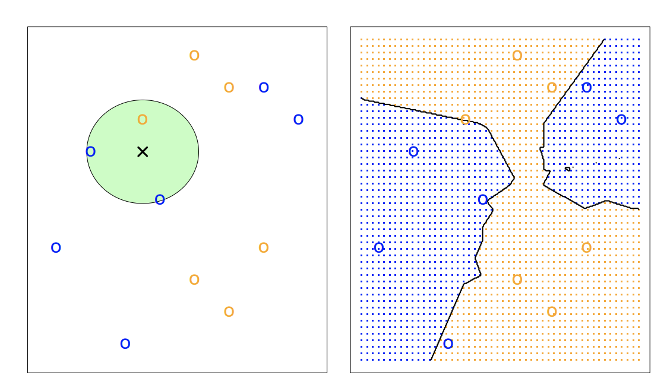
K-nearest neighbors (KNN)
K = 3, Euclidean distance
“An Introduction to Statistical Learning” by Gareth James, et al. 2013

Slide 19
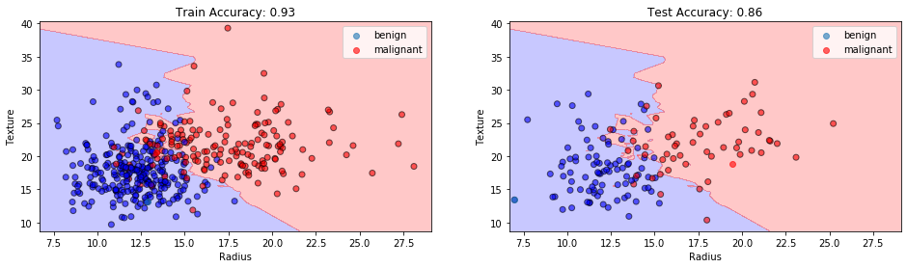
K-nearest neighbors (KNN)
KNN Classification at K=3
When the value of K is too low, the model picks only the points that are closest to the data sample, thus forming a very complex decision boundary (too rigid). Such a model often fails to generalize well on test data, thereby showing poor results.
https://towardsdatascience.com/k-nearest-neighbors-94395f445221

Slide 20
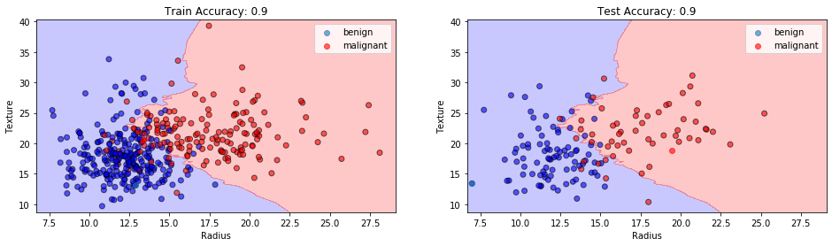
K-nearest neighbors (KNN)
KNN Classification at K=11
As we increase the number of neighbors, the model starts to generalize better.
But increasing K too much may decrease the performance on test data.
How to pick the best K?

Slide 21
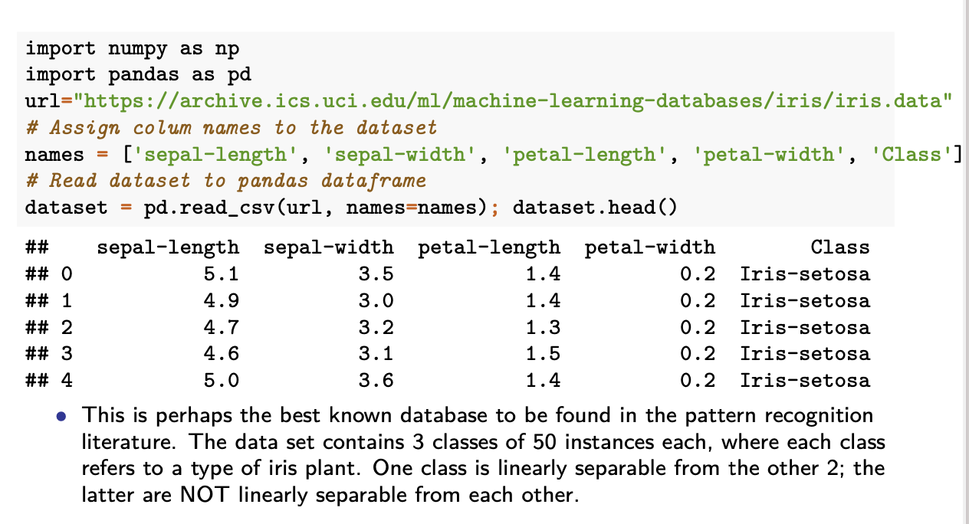
Python implementation

Slide 22
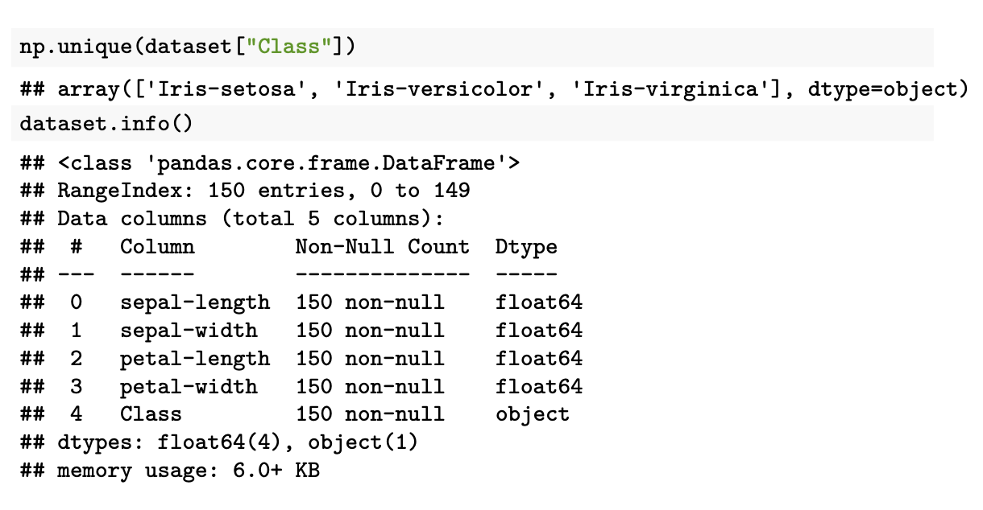
Python implementation

Slide 23
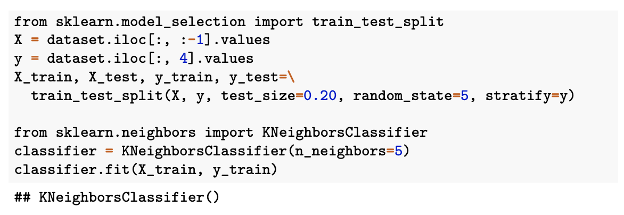
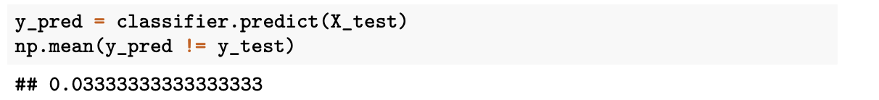
Python Scikit-learn package
Model training:
Prediction on test data:
When could accuracy be a bad measure for evaluating model performance?

Slide 24
Threshold & trade-offs btw. errors
True news distribution
Fake news distribution
Low sensation
High sensation
How to pick a sensation score threshold to identify fake news?
Notes:
Also talk about flip result

Slide 25
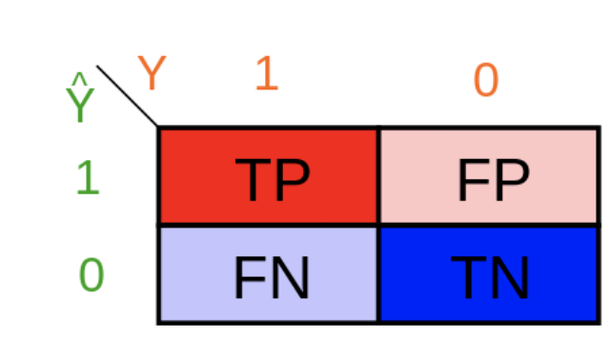
Confusion matrix
True positive rate:
TP / (TP + FN)
= TP / size of 1
False positive rate:
FP / (FP + TN)
= FP / size of 0
Accuracy = (TP + TN) / n
Accuracy is misleading in imbalanced datasets.
For a given threshold, you can calculate a value for each metric.
When TPR increases, FPR also increases (capturing the trade-off between two types of errors).
Notes:
Predicting 0 for all samples, then FP = 0
Predicting 1 for all samples, then FN = 0

Slide 26
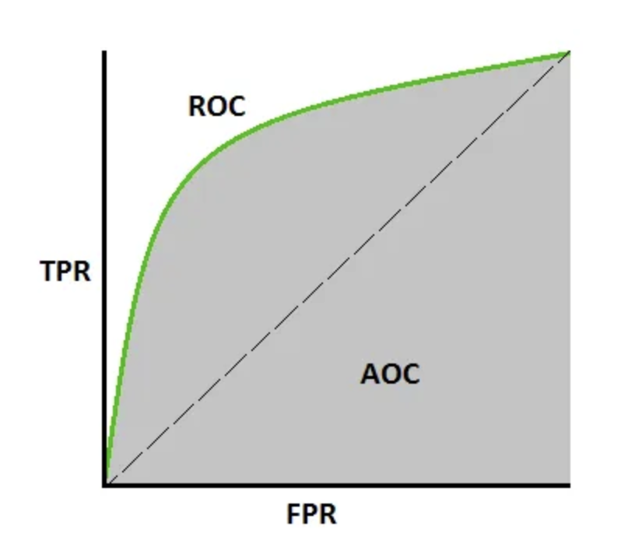
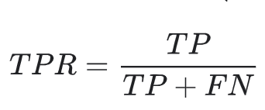
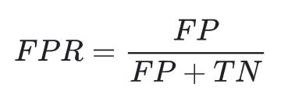
Receiver operating characteristic (ROC)
1
AUC
0
1
Calculate TPR & FPR for each prob threshold.
TPR and FPR are positively correlated.
ROC curve: always start from (0, 0) and end at (1, 1).
Notes:
Both have their denominators fixed as the two classes’ population size.

Slide 27
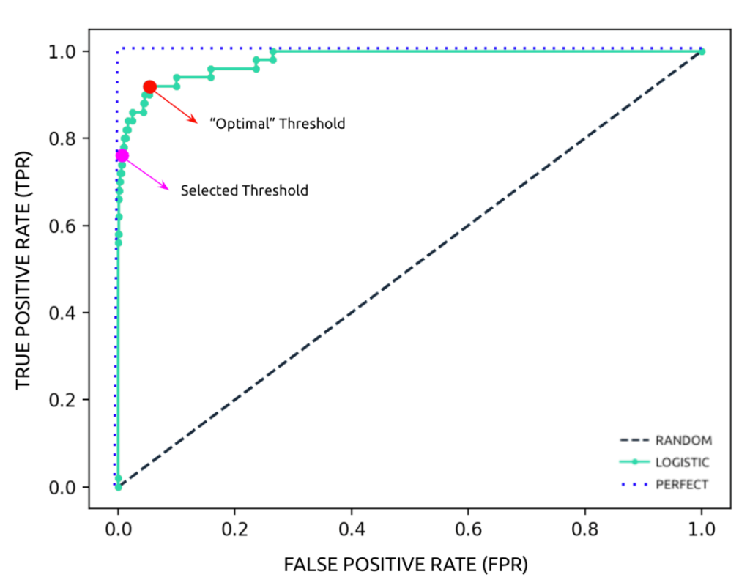
Choose the best threshold for a model
Does the KNN model have a threshold parameter?
Optimal threshold: maximizing the difference between TPR and FPR;
Selected threshold: highest TPR at the maximum acceptable FPR;
In practice, most models use the default 0.5 for binary classification.
In general, people care less about picking the best threshold. AUC-ROC is mostly used as a summary statistics of model performance.
(Cross-validation on test data is more important/reliable.)
Notes:
the standard K-Nearest Neighbors (KNN) algorithm doesn't inherently use a threshold; it makes decisions based on the majority vote of its k nearest neighbors.
However, you can introduce a threshold by using the confidence scores calculated by KNN (what fraction of K obs are positive) to achieve a desired trade-off.

Slide 28
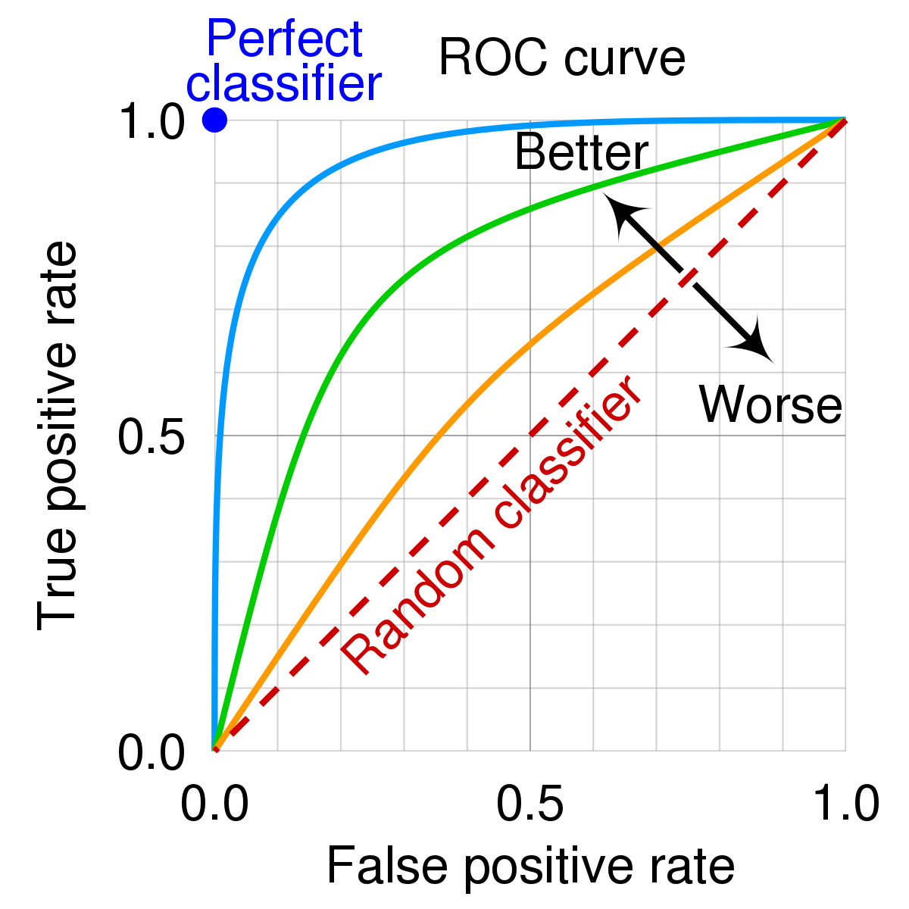
AUC for comparison btw. models
Based on the area under the ROC curve (AUC);
It’s more appropriate when two classes are balanced;
What about imbalanced datasets? (cancer diagnosis, spam)

Slide 29
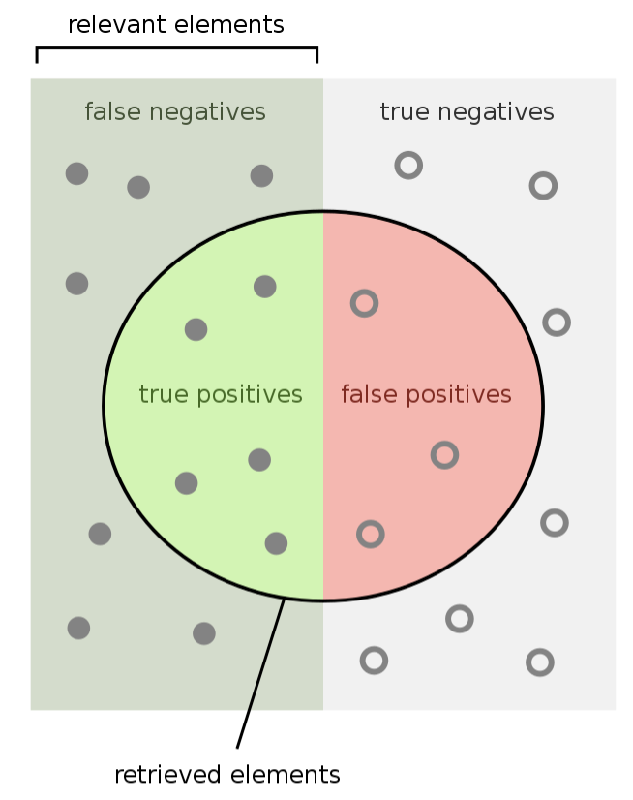
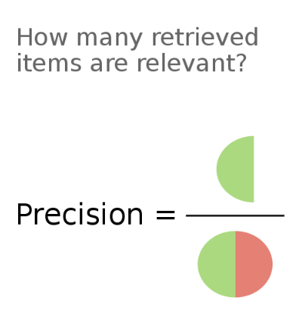
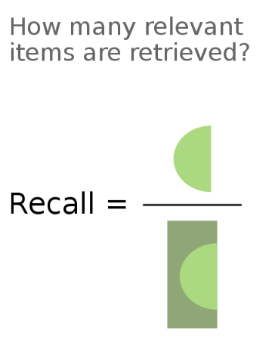
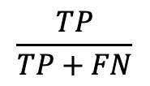
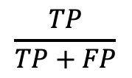
Precision vs. recall (focus on minor class)
=
$$\frac{TP}{TP+FP}$$
=
$$\frac{TP}{TP+FN}$$
Notes:
You should use precision and recall to evaluate performance on the minority class when there is a class imbalance, as these metrics can reveal issues with how well the classifier identifies the specific minority class, which a simple overall accuracy score would hide.

Slide 30
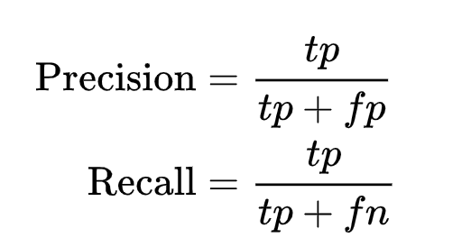
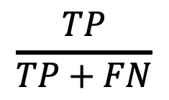
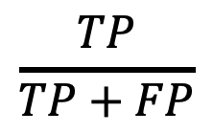
Trade-off between precision and recall
$$\frac{TP}{TP+FP}$$
$$\frac{TP}{TP+FN}$$
Precision and recall (same as TPR) are often inversely related.
Increasing precision typically decreases recall and vice versa.
E.g., A model can achieve a high precision by only predicting positive when it is very confident; recall = 1 when always predicting positive.
Precision is undefined when only predicting negative.
Can plot precision against recall at different thresholds.
Discussion: Which metric is more important in Spam filtering?
What about Covid testing?
Notes:
However, the importance of the minority class depends on the specific goal of the model
You want to be very careful in predicting an email as spam because you will delete it.
But in COVID-testing, the recall is more important because if you miss one, many people will get infected. To improve recall, you can predict many people as COVID positive as possible. (the same as cancer detection)

Slide 31
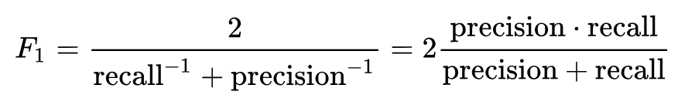
F₁-score: summarizing PR
F₁ score cares equally about precision and recall;
Can be used to choose the best threshold for a model to make prediction/classification;

Slide 32
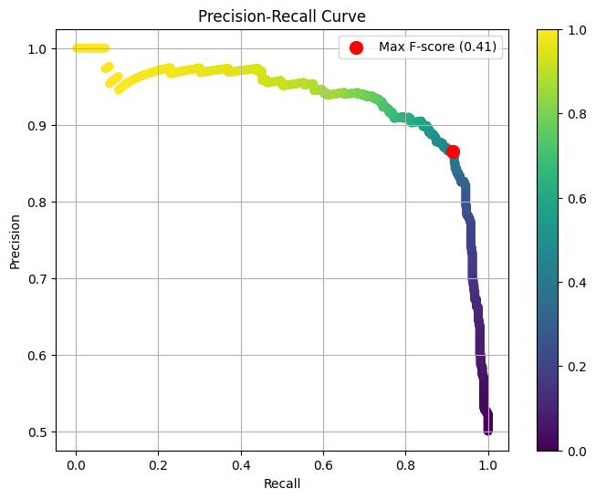
F₁ score for picking model threshold

Slide 33
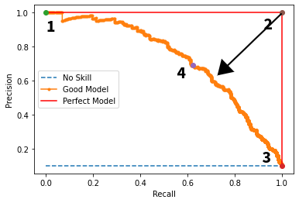
PR curve for model comparison
A random classifier makes a flat Precision-Recall curve, with precision equal to the proportion of positive instances in the dataset.
AUC (area under the curve) score closer to 1 means better performance.
More reliable than ROC for imbalanced datasets.

Slide 34
Summary
ROC curves summarize the trade-off between the true positive rate and false positive rate for a predictive model using different probability thresholds.
Precision-Recall curves summarize the trade-off between the true positive rate and the positive predictive value for a predictive model using different probability thresholds.
ROC-AUC is more appropriate when the observations are balanced between each class, whereas precision-recall curve or F1 score are appropriate for imbalanced datasets.

Slide 35
So far …
Supervised classification models: logit, naïve bayes, KNN
True/False positive rate, Precision and Recall, F1-score
How to fine-tune and select the model that has the best performance on unseen data (a.k.a. the model with high generalizability)?
[Avoid overfitting/gaming the model too much on training data, which is only a sample of all data]
Notes:
Both tasks require model evaluation.

Slide 36
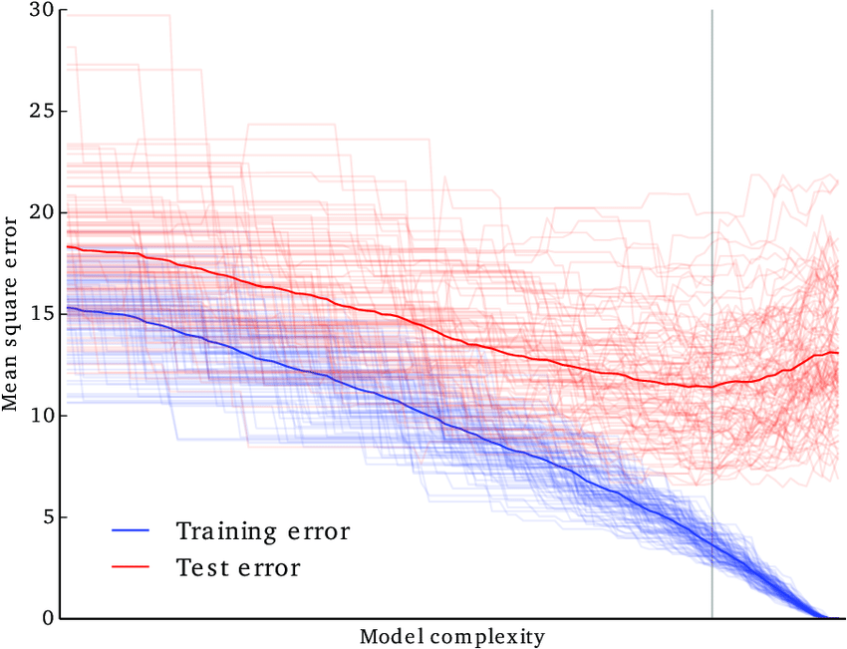
Model evaluation on test data
Evaluating models on the test data (unseen by the model) is the best choice to compare model performance.
Applicable to both regression and classification tasks.
What if there is no test data?
What if the training data is small?

Slide 37
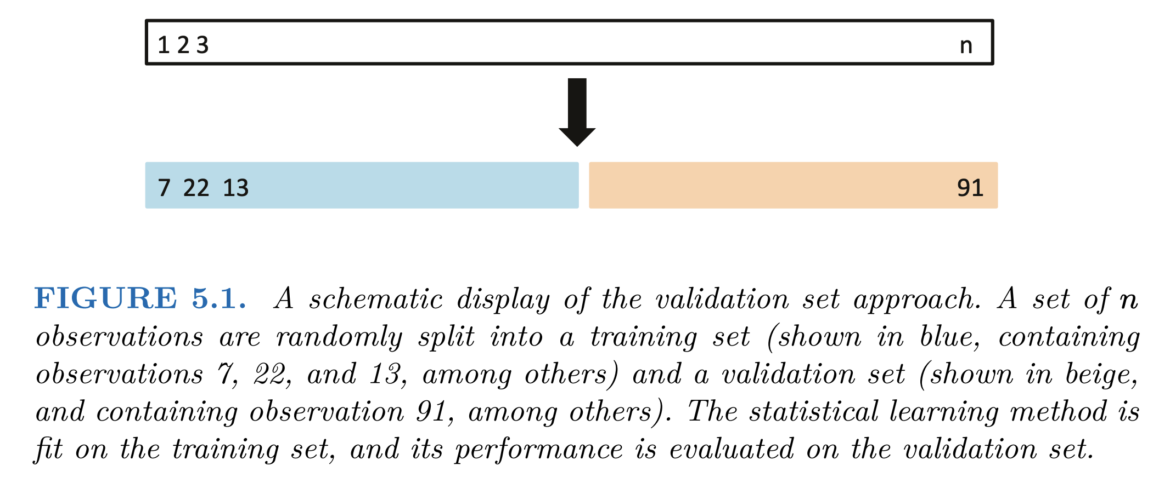
The validation set approach
Randomly divide the available set of observations into two equal parts, a training set and a validation set or hold-out set. Fit a model on the training set, and the fitted model is used to predict the responses for the observations in the validation set.
James, Gareth, et al. An introduction to statistical learning: with applications in R.

Slide 38
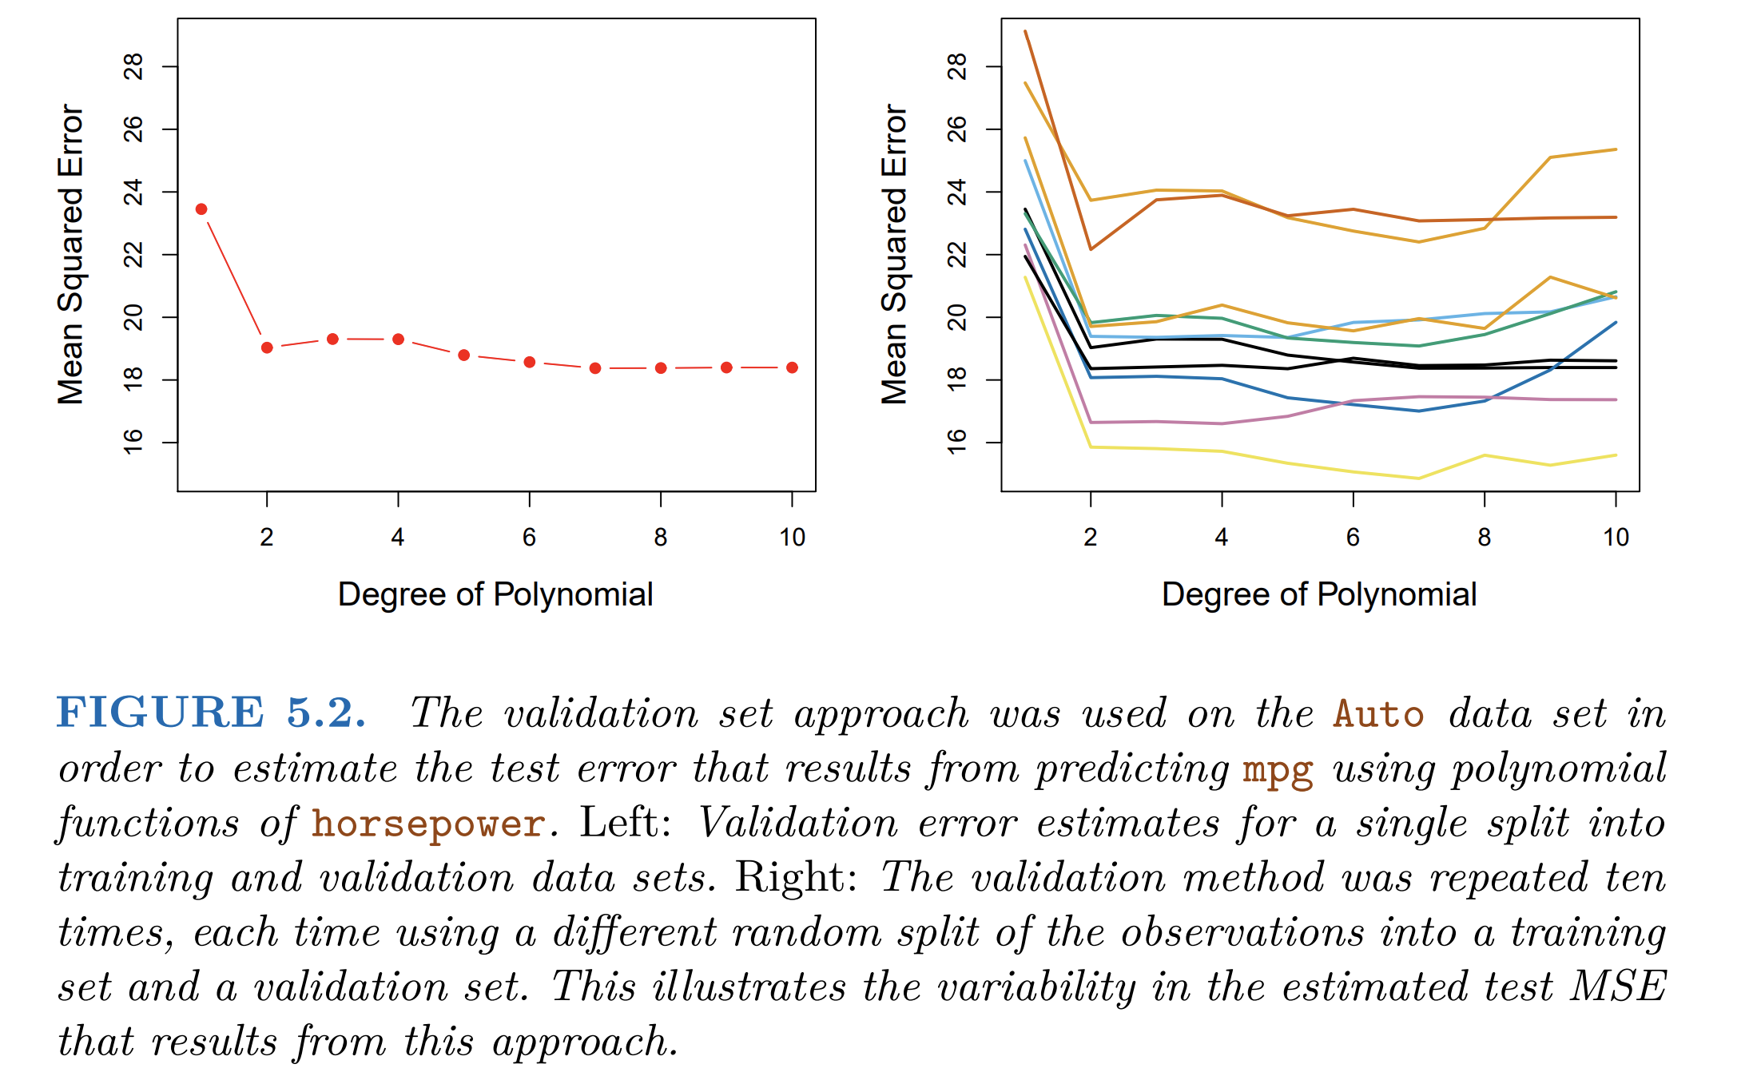
The validation set approach
James, Gareth, et al. An introduction to statistical learning: with applications in R.

Slide 39
The validation set approach
Drawbacks of this approach: • the estimate of the test error rate can be highly variable; • only half of the observations are used to train the model;
Resampling methods: a refinement of the validation set approach that addresses the two issues.

Slide 40
Resampling methods
Repeatedly draw samples from a training set and refit a model of interest (or compute certain estimates) on each sample to obtain additional information about the model (or estimates).
Common methods include cross-validation and bootstrap.
Useful when you have small sample size.

Slide 41
Cross-validation (CV)
In most problems, there is no designated “test dataset” that is huge in size and set aside a priori. We can reserve part of training data as test.
Cross-validation (CV) can be used to estimate the test error associated with a given statistical learning method:
to evaluate its performance (model assessment)
or to select the appropriate parameter (model selection/tuning)
CV can be used for both classification and regression.
A precursor of CV is the validation set approach that randomly divides the dataset into two equal parts.
CV has a few variants; we only discuss the canonical version.

Slide 42
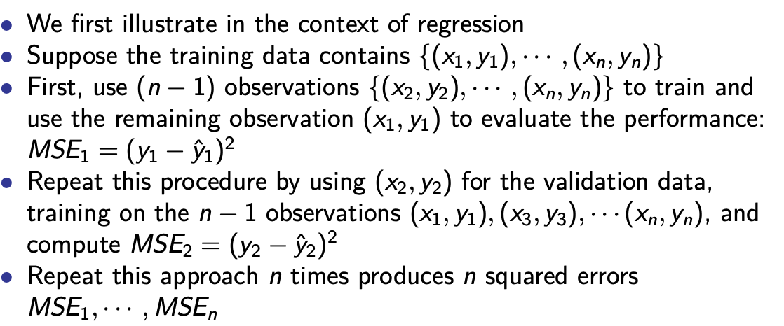
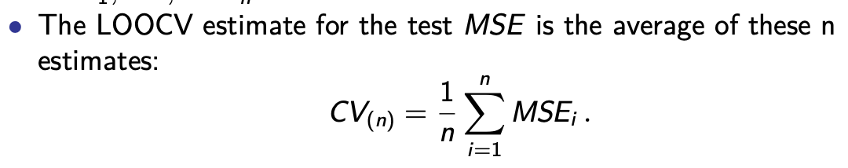
Leave-One-Out cross-validation (LOOCV)
There is no need to randomly shuffle the training data for LOOCV. Why?

Slide 43
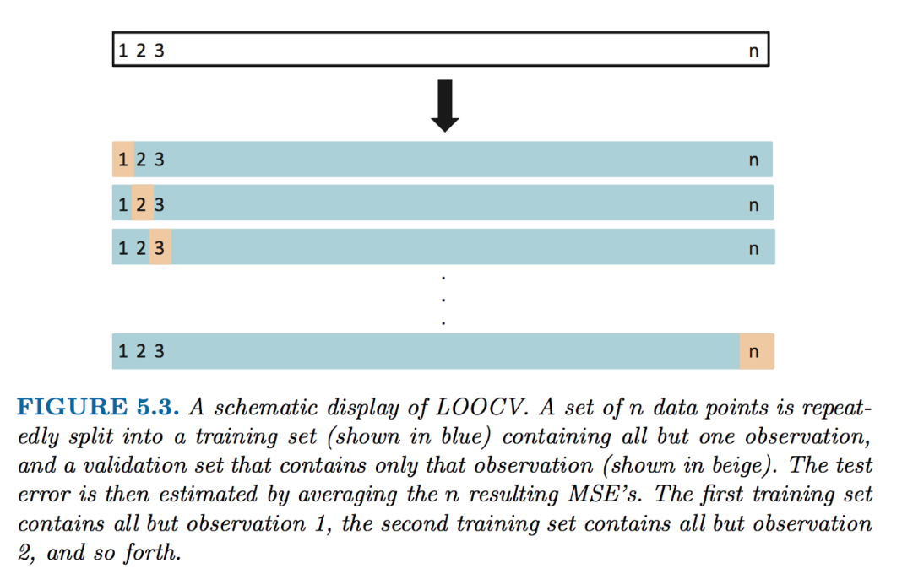
LOOCV
James, Gareth, et al. An introduction to statistical learning: with applications in R.

Slide 44
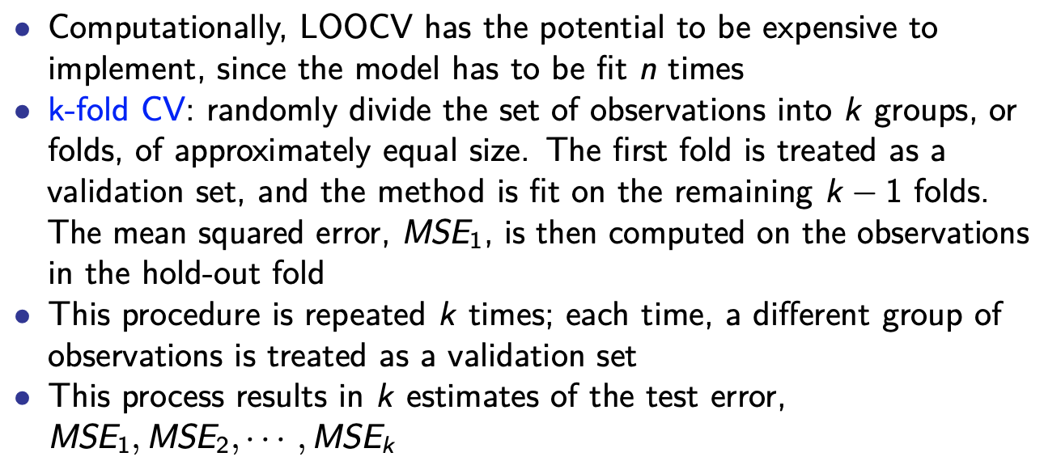
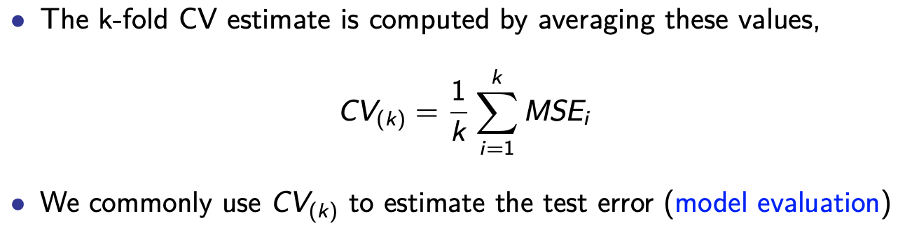
More common: k-fold CV

Slide 45
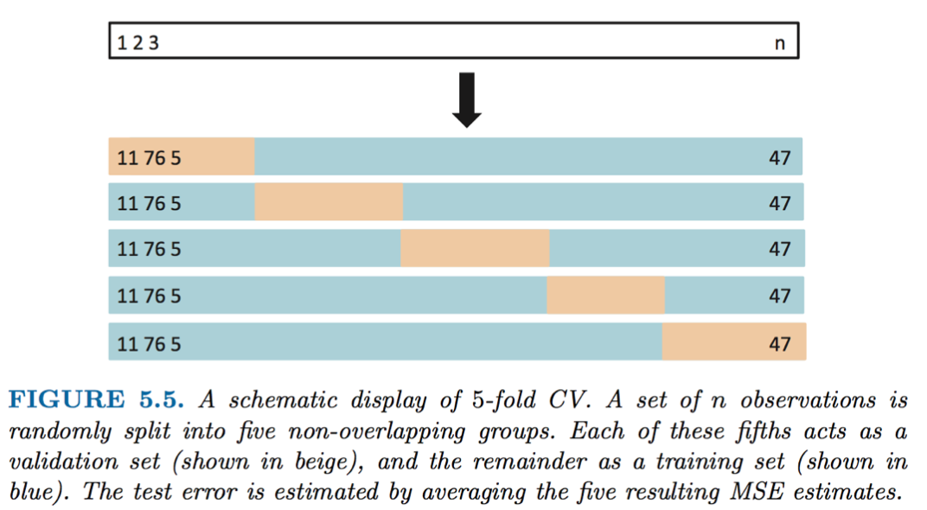
K-fold CV
LOOCV is a special case of k-fold CV in which k = n.
James, Gareth, et al. An introduction to statistical learning: with applications in R.

Slide 46

K-fold CV is very close to LOOCV
Why is the variance of test errors in 10-fold CV much lower than that in the validation set approach?

Slide 47
More about k-fold CV
The usual choices for k in practice are k=5 and k=10.
Sometimes, when people have enough computing power, they do 10-fold CV multiple times and then take the average performance.
The cross-validation criterion should be consistent with prediction evaluation criterion (group discussion on the following questions):
Think about the MSE in 10-fold CV for the regression we just introduced. Are they consistent with the out-of-sample MSE?
For classification, if we care about classification error, what CV criterion should we use? What if we care about the ROC curve?
Notes:
Yes
Accuracy
AUC size

Slide 48
k-fold CV for model tuning/selection
Suppose in the Auto dataset, we are deciding between two linear models.
model 1: use displacement to predict mpg
model 2: use displacement and horsepower to predict mpg
To choose between these two models using 5-fold CV, we calculate CV₍₅₎ for both models and choose the model with the better CV₍₅₎.
The same idea extends to the case of many models.
After you have chosen the best model, which of the 5 linear prediction equations do you use finally?
None! We refit the model with all the available training data.
Can we use k-fold CV to fine-tune parameters in a model?

Slide 49

Bootstrap in statistics
Bootstrap: any procedure that relies on random sampling with replacement (from the original sample);
Random sampling with vs. without replacement;

Slide 50
Bootstrap
As a verb, bootstrap means “get oneself out of a situation using existing resources without extra help”.
Bootstrapping is a procedure for estimating the distribution of an estimator by resampling (often with replacement) existing data.
Bootstrap can be used to estimates the properties of a statistic. (e.g., mean, variance, confidence intervals, prediction error, etc.)
This is a rather strange idea when we first look at it.
However, it is one of the most influential ideas in statistics in the second half of the 20th century.
Bootstrap is computationally heavy.
Bootstrap has different versions (e.g., moving block bootstrap for time series data). We only discuss the simplest kind.
With bootstrap, how do we estimate the confidence interval of sample mean?

Slide 51

Bootstrap works in practice
Notes:
Imagine alpha is the happiness score/level of HK college students.
We can calculate the avg for each class, do it for 1000 different classes.
What if we only have access to data for one class?

Slide 52
Course Notes
Get started on HW1 (two extra weeks are given).
Sample questions for class projects:
Social Media Sentiment Analysis: Analyze Twitter / Reddit posts related to a recent social event or political movement using natural language processing tools to track public sentiment / engagement and use network measures to identify influencers.
Network Analysis of Online Communities: Use NetworkX to analyze the follower or mention network in a dataset from Facebook or Reddit, exploring metrics such as centrality, clustering, and community detection to understand group dynamics.
Team Communication Patterns and Performance: Use a sample of Wikipedia dataset to study how communication or collaboration patterns between team members are associated with the quality of article (regression models and causal inference).
Text Mining of News Articles: Collect and process a corpus of news articles on climate change or other issues using techniques such as LDA to identify emerging themes and differences across types of media outlets (e.g., by political affiliation).

Slide 53
Course Notes
Sample questions for class projects:
The impact of AIGC on User Engagement: Examine whether AI-generated content is related to increased user engagement metrics such as likes and comments. Can use any dataset of social media posts. Design a ML pipeline to classify AIGC posts. Use regression or causal inference frameworks to quantify the effect of AIGC.
Linguistic Analysis of Paper Acceptance: Study what kinds of linguistic features such as LIWC categories or promotional words are correlated with paper acceptance rate. Can use the ICLR dataset combined with OpenAlex API. Robustness test of causality.
Predicting Movie Popularity / Rating (Use rotten tomatoes data)
Examining Language Differences across Demographic Groups in Online Dating
(Use OkCupid data)
…
…
…

